Slide 1

NETRALITY
SPRINT FINAL
TEAM TVS
Tirth,Vishal & Sakshi

Slide 2

PROBLEM STATEMENT
The main challenge presented by Netrality was to identify potential customers from a prospect customer list, leveraging data-driven insights and machine learning techniques. Netrality provided three key CSV files: one containing the current customer list, another with the current billing data of current customers over various locations, and the third with the prospect customer list.
The primary objective was to use the provided data sets to develop a predictive model that could identify potential customers from the prospect list. This involved exploring and cleaning the data, understanding the relationships between different features, and applying machine learning algorithms to make predictions.
Notes:
Problem statement

Slide 3

DATA OVERVIEW: Netrality Datasets
GOOGLE SLIDES
POWERPOINT
CANVA
CURRENT CUSTOMERS
CURRENT BILLING
PROSPECT LIST
The current customer dataset contains the numeric and descriptive information of the current customers of Netrality.
Current Billing dataset contains the billing information over different areas of the current customers.
The prospect list dataset contains the numeric and descriptive information of the prospect customers of Netrality.
Notes:
Slide 2: Data Overview
Title: Data Overview - Netrality Datasets Content:
Describe the three datasets: Current Customers, Prospect Customers, and Current Billing.

Slide 4
METHODOLOGY OVERVIEW
.
1.
We analyzed Netrality's business and the data they had provided and we gained valuable insights into their requirements. We then employed machine learning algorithms and business propositions to evaluate our next steps.
Next up was cleaning the data. Proper care was taken to make sure the data was accurate and consistent. At the same time, some new features based on our industry knowledge to catch important aspects of how customers behave have been added.
In simple terms, it was made sure that the data was in good shape and had all the right information before digging into it to find useful insights.
.
2.
Notes:
]

Slide 5
EDA and Feature Engineering
Various steps have been taken to clean the given data so that it is fit for the analysis. Various cleaning, scaling and normalization methods have been incorporated to produce accurate models and results.
Few new features have been created on the basis of existing features such as Budget Ratios, Total Budgets, Age of the company which contributed to the efficiency of the predictions.
Log transformations and scaling methods such as Min-Max scaling have been done to ensure the data is converted into consistent values for smoother and efficient analysis.

Slide 6
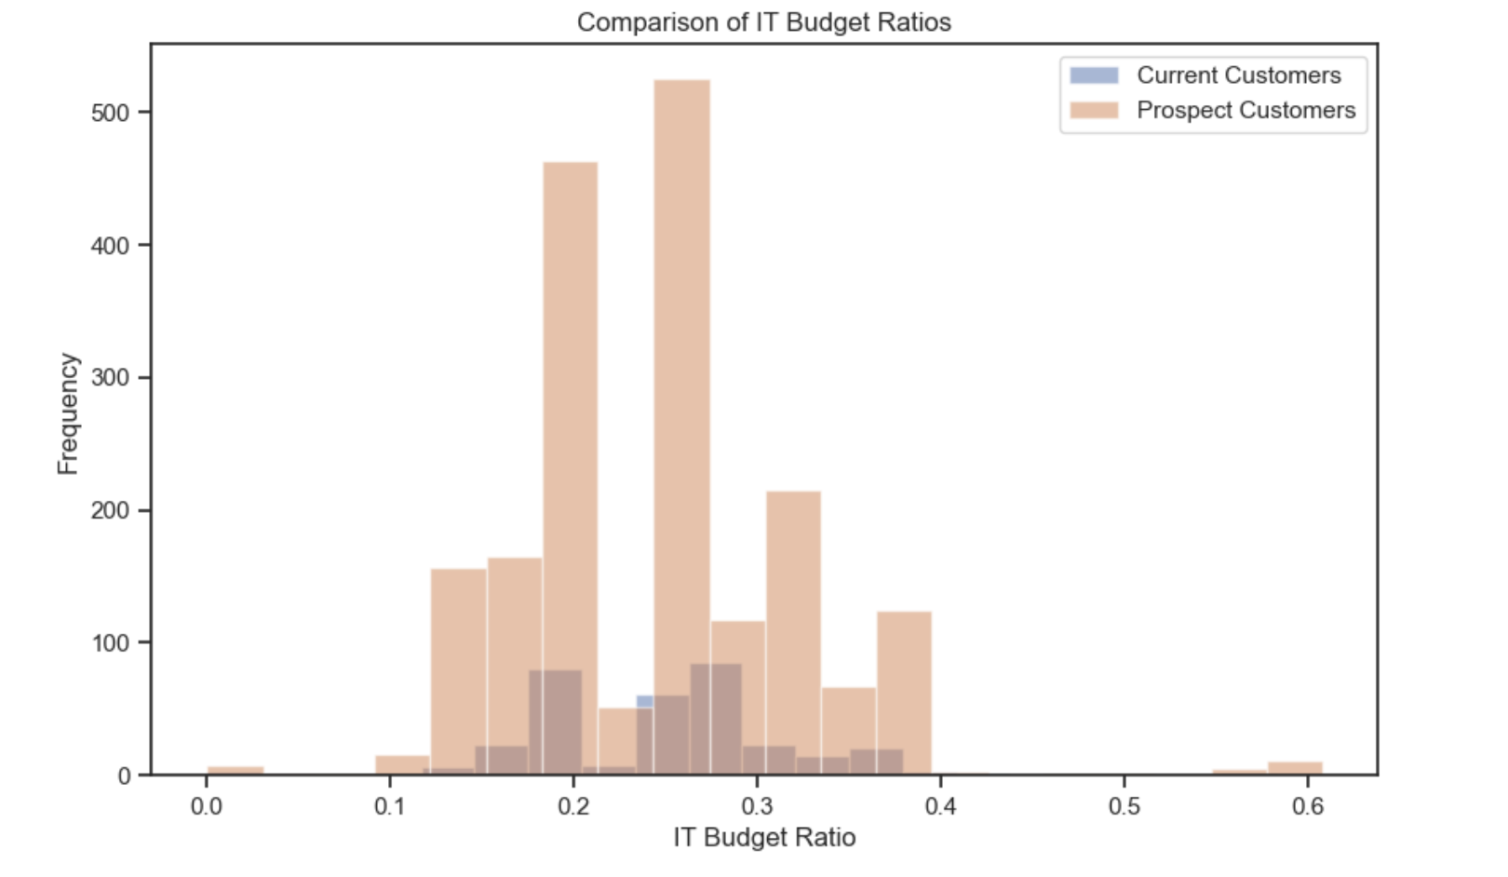
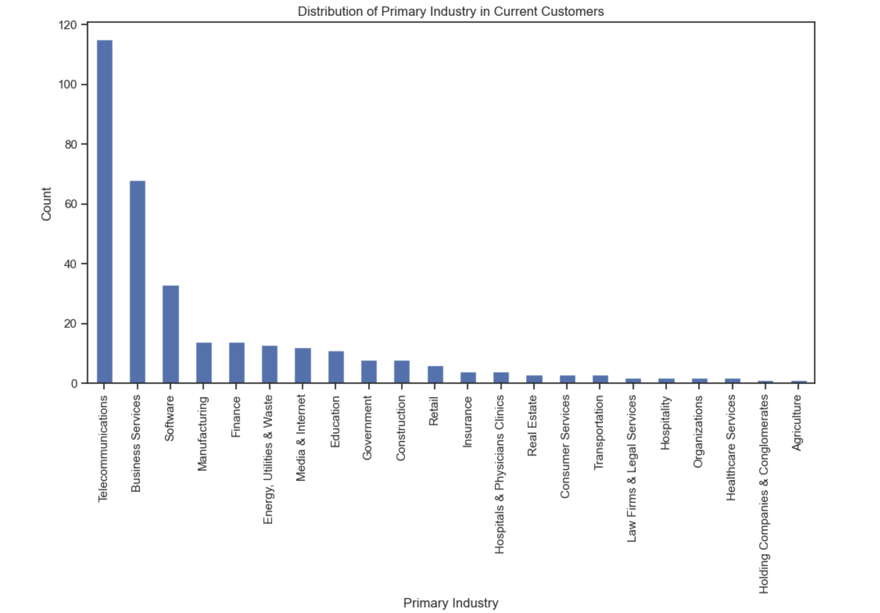
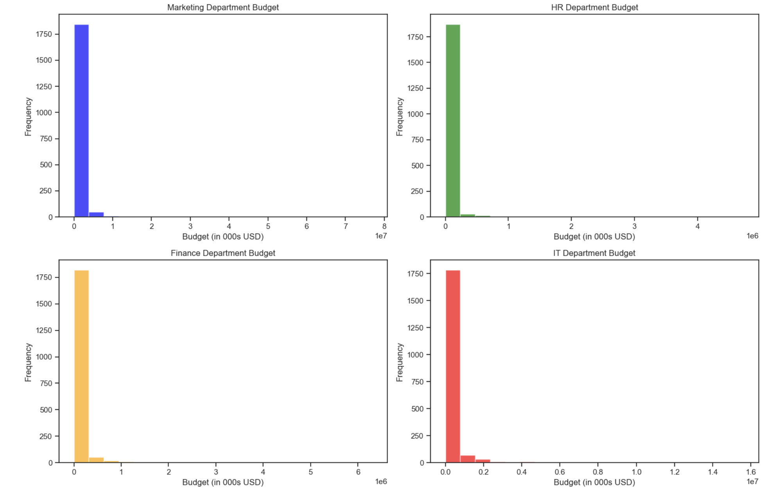
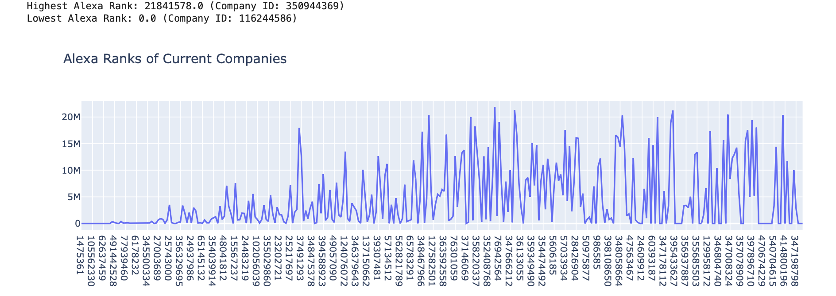

Slide 7
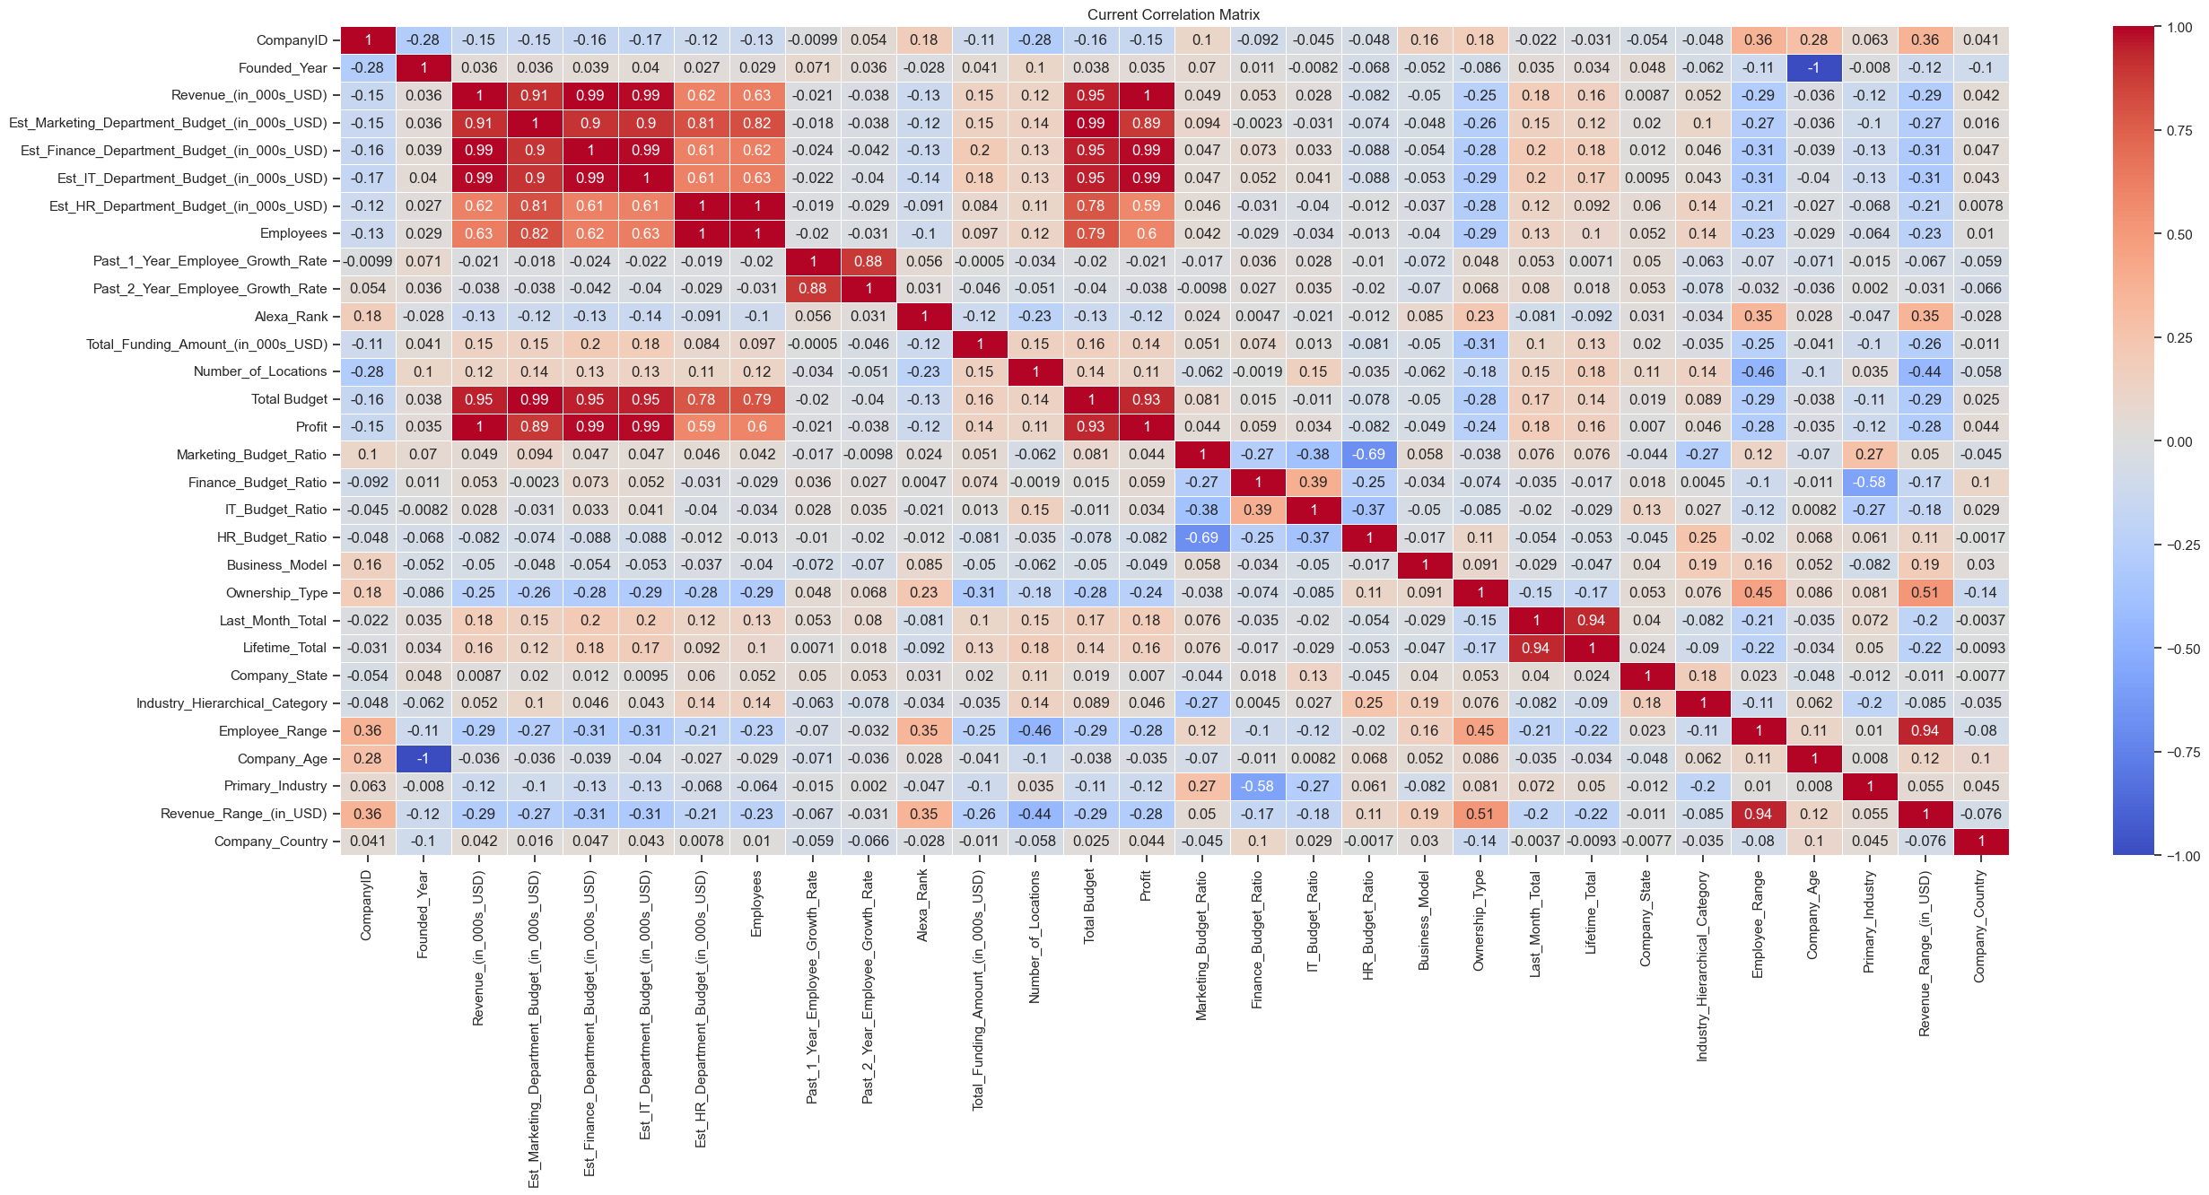
Correlation between the features

Slide 8
FEATURE SELECTION AND TARGET VARIABLE
1.
1.
Feature Selection :
We chose key info from Netrality's data, like Locations, Employee Count, and Total Funding, to understand their size and growth potential. Adding in customer behavior data, such as past purchases, gives us a complete view. This mix ensures our model is built on a solid foundation for accurate predictions.
Target Variable :
Our focus is on 'Revenue' because it's a straightforward measure of Netrality's success. By tracking revenue, we can identify high-value customers and predict future financial outcomes. This practical approach helps Netrality plan smart strategies for real, actionable business growth.
2.
2.
Notes:
]

Slide 9
Model Development and Insights
Various regression models were put to the test, including Linear Regression and Decision Trees. The selection was based on a matrix of accuracy, interpretability, and computational efficiency, leading to the adoption of the Random Forest Regression model as the prime analytical tool.
The Chosen Model: Random Forest and CatBoost
We chose to use the Random Forest and Catboost models because they have proven to be good at handling complex data without getting too caught up in the details. It's like having a tool that strikes a good balance between getting things right and being easy to understand. This choice was important for making our project successful.
Notes:
]

Slide 10


Performance Metrics
A lot of effort was put into fine-tuning and teaching the Random Forest model and CatBost model to be really good at making predictions. Observations and actions have been done to certain settings to make sure it works as accurately as possible.
On measuring their performance using some numbers - the RMSE is 0.9693, the R2 score is 0.8987, and the MAE is 0.5915. Metrics for the CatBoost model have been as follows :
RMSE= 0.969, R2 score was 0.898 and MAE is 0.642These numbers portray that the model is really good at predicting things accurately and you can trust its predictions.
Notes:
Vishal

Slide 11
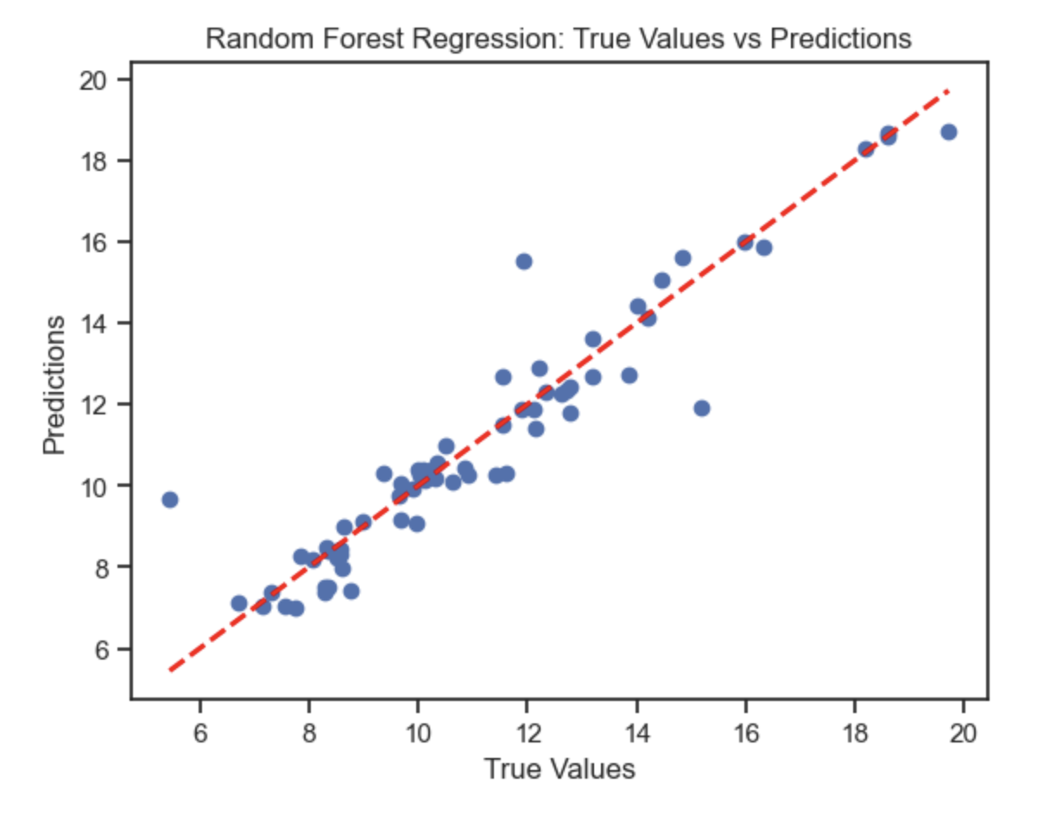
Model Overview
A key outcome of the random forest model was the identification of significant predictive features, providing vital insights into customer attributes that are most indicative of potential for conversion.
The random forest model excels in identifying which attributes of a prospect are most indicative of their likelihood to become a customer. This is achieved through the model's ability to evaluate the predictive power of each feature with respect to the target variable — in this case, the potential for customer conversion.
Notes:
Add the actual vs predicted graph

Slide 12
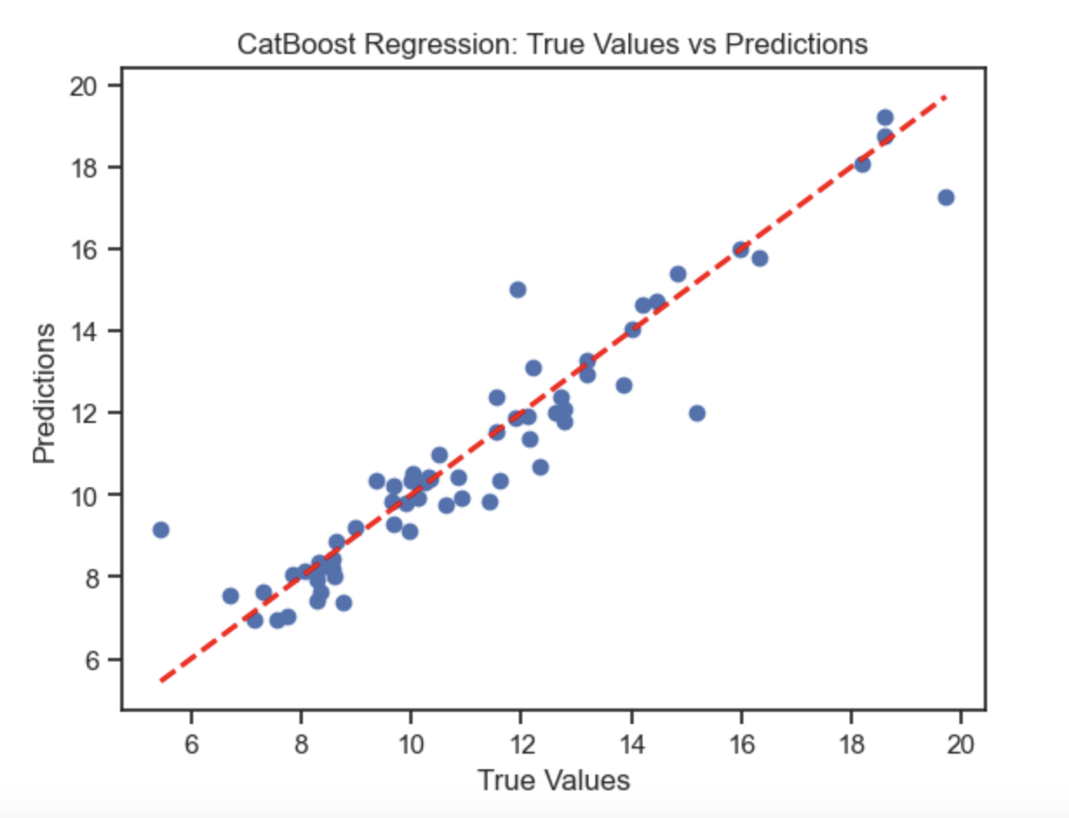
Model Overview
A CatBoost model has also been tuned to predict prospect customers since both the models turned out to portray similar performance metrics.
The final customer list includes the common prospect customers from both the CatBoost model and the Random Forest Regressor.
Notes:
Add the actual vs predicted graph

Slide 13
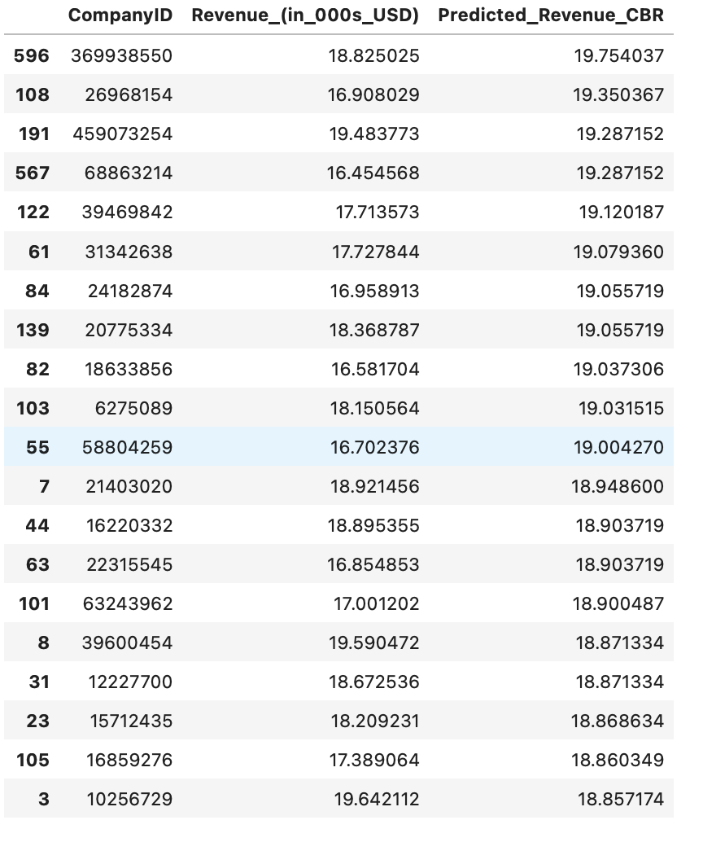
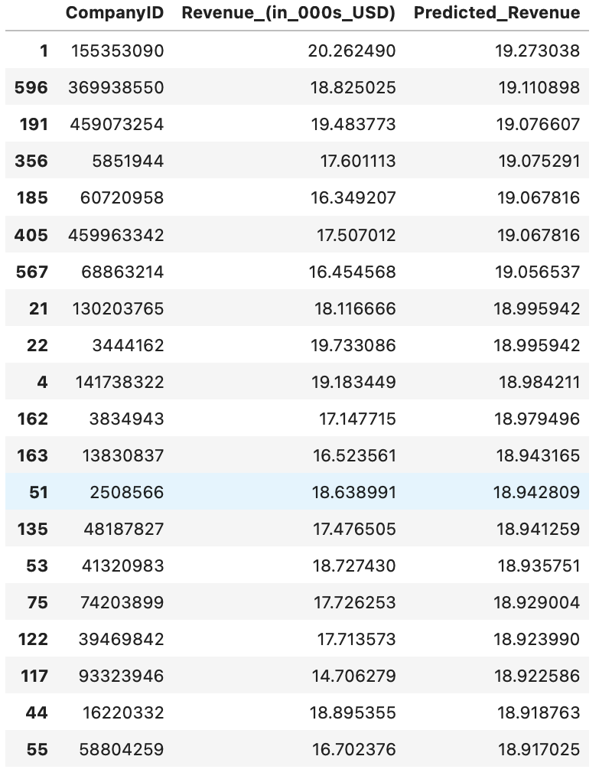
Prediction Outputs
CatBoost Model Predictions
Random Forest Model Predictions

Slide 14
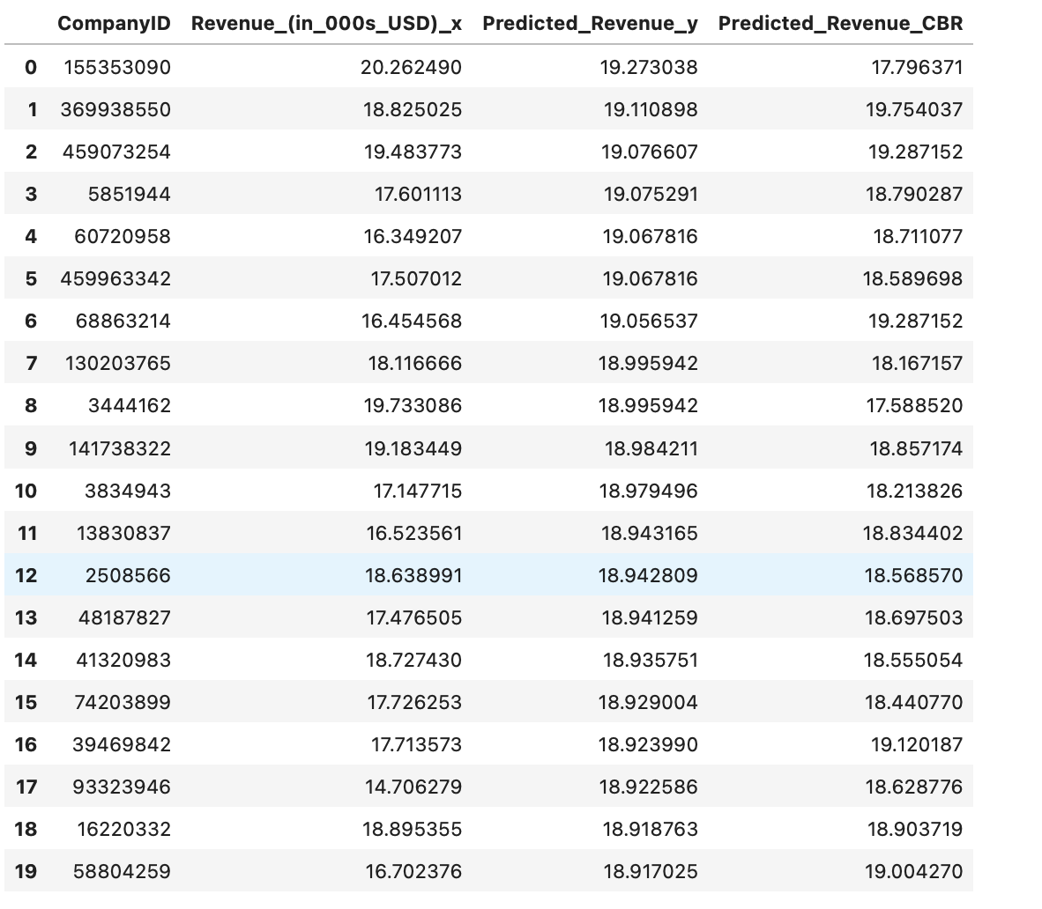
Insights from the Model Analysis
Based on the model's insights, strategic recommendations were formulated for Netrality. We have the top 20 companies listed out. These focused on targeting specific customer segments and leveraging influential customer attributes to enhance conversion rates and drive business growth.

Slide 15
Conclusion and Future Directions
In summary, our project has successfully demonstrated how data analysis can be a powerful tool for improving business decisions. By using the Random Forest Regression model, we've analyzed our datasets to identify potential customers more effectively. This approach combines technical accuracy with practical business insights, leading to smarter strategies for customer engagement and growth.
Our work shows that even complex data can offer clear guidance for business choices. We've not only predicted potential customers but also gained valuable insights that can shape marketing and sales efforts. This project is a testament to the power of blending data science with business understanding.
Looking ahead, we see this as a step towards more data-informed strategies in our business operations. Our focus remains on making decisions that are not just based on intuition but backed by solid data analysis.
Notes:
vishal

Slide 16

Thank You
- TEAM TVS
WE ARE OPEN TO ANY QUESTIONS OR DISCUSSIONS !

